Slide 1
AP Statistics
Section 8.1
Binomial Distribution

Slide 2
What is Important: HOW DO YOU KNOW if an event is “BINARY”?
Conditions for Using a Binomial Distributions
Condition #1: Each trial can have ONLY TWO Possible outcomes
  Ie; Pass or Fail, boy or not boy, true of false, Right or Wrong, Even, or Odd
Condition #2: Constant Probability of Success
  Probability of success in each trial must be the consistent [“P” is constant]
  The probability of success and failure must add to 100% [NOT equal]
Condition #3: Each trial must independent
  Outcome of any individual trial doesn’t affect the probabilities in other trials
  Drawing cards → replacement, probability must be the same!!
Condition #4: Fixed number “n” of trials
  The number of trials is set, this conditions separates Binomial vs Geometric Distributions

Slide 3
What is the objective of This Section??
The main objective is to know how to use a “NORMAL” approximation to calculate probabilities when the “DISTRIBUTION” is binomial
Ie: Suppose we know that 30% of electric cars are faulty. If we take a sample of 1500 cars, what is the probability that 500 cars or less is faulty
When the number of trials are few [ie: n=10 or 15] we would use binomialcdf or binomialpdf to calculate our probabilities
When the number of trials are bigger [ie: n=100 or 1500] it requires less computational power if we calculate our probabilities using a normal approximation
Q1: Is it BINARY? HOW do we know? What conditions must be met?
Q2: Can we use a normal approximation for the binary distribution? What conditions must be met?
Q3: What is the mean & std deviation of the distribution?

Slide 4
OverView of Lesson:
The purpose of this lesson is to understand how a distribution of outcomes would look like if the results were “binary”
ie: The probability of a Tesla having any faulty components is 1/30. You randomly select 15 Tesla’s. How many of them do you expect do have a faulty component?
  This situation is “binary” because a Tesla can be either “faulty” or “not faulty”
  The distribution for the number of faulty cars could be normally distributed or skewed
Q: For what conditions will the distribution of a “binary” event be “normally distributed”?
  There are 5 conditions:
  Binary Outcomes, constant probability, Independence, fixed number of trials
  5th condition:

Slide 5
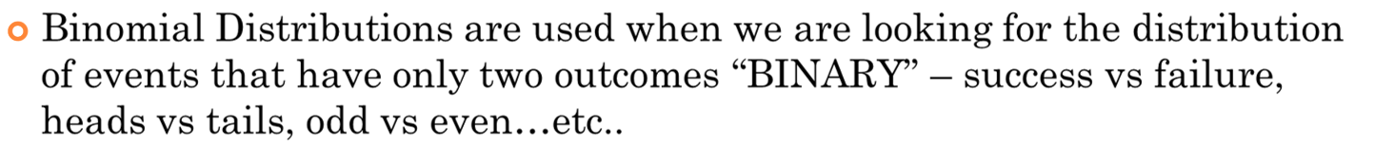
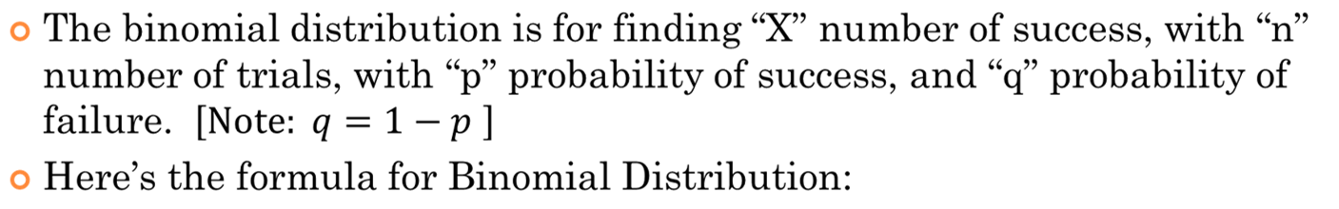
Binomial Distributions
The probability of all the failures combined
The probability of “X” number of success
Out of “N” trials, we choose “x” number of success
The probability of all the successes combined

Slide 6
Ex: In each of the following cases, decide whether or not a binomial distribution is an appropriate model, and give your reasoning:
a) You draw 10 four cards from a deck without replacement and then find the probability of getting 4 clubs
No, because the probability of getting a club after each draw is changed
b) 30 women in a hospital gives birth to a child. The probability that 10 of them gives birth to a female are taken.
Yes, the outcomes can be only be female and not female. Each birth is
independent of the other
c) A scientist conducts a solubility test 20 times on the same substance. He raises the temperature by 3 degrees after each test. She counts the number of times a chemical reaction would occur.
No, because the increase in temperature changes the outcome of each trial
d) Bobby is in a school with 300 students. He will randomly ask one student a day to be his friend for 100 days in a row. He counts the number of yeses.

Slide 7
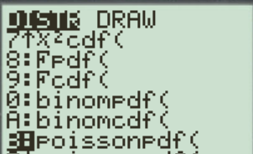
Binomial PDF vs CDF
  BinomPdf: Binomial Probability Distribution function
  Computes the probabilities of exactly “X” number of
  successes, with “n” trials, and “p” probability of success
  2nd/Vars/0:Binompdf
  binompdf(n,p,x)
  ie: the probability of having exactly 4 correct answers on a MC
  test with 10 questions and 4 choices each
  BinomCdf: Binomial Cumulative Distribution Function
  Calculates the probabilities “UP TO” X number of successes [From zero to “X”]
  2nd/Vars/A:binomcdf
  Binomcdf(n,p,x)
  ie: the probability of having UP to 4 correct answers [includes 0, 1, 2, 3, and 4]

Slide 8
Revisiting the Binomial Probability Formula
“n” – number of trials
“p” – probability of success in each trial
“q” – probability of failure in each trial (q =1 – p)
“X” – number of successes in “n” trials
Probability for “X” number of
success in “n” number of trials
Ex: A basketball player has a free throw percentage of 85%. If he takes 5 shots, what is the probability he will make exactly 3 of them?
There’s a 13.8 chance that he will make exactly 3 of his 5 shots

Slide 9
Ex: A multiple choice quiz has 10 questions with 4 choices in each question. If you randomly guessed what is the probability that you get exactly 4 questions correct?
There’s a 13.8 chance that he will make exactly 3 of his 5 shots
Ex: A multiple choice quiz has 10 questions with 4 choices in each question. If you randomly guessed what is the probability that you get atmost 4 questions correct?
Atleast 10 means that you can have 0, 1, 2, 3, or 4 correct answers

Slide 10
Ex: Suppose you have a test with 20 multiple choice questions with 4 options each. What does each of the commands represent?
i) binompdf(20,0.25,11)
ii) binomcdf(20,0.25,11)
Getting exactly 11 correct
Getting exactly 11 or less correct
iii) 1 – binomcdf(20,0.25,5)
iv) binomcdf(20,0.75,12)
Getting 6 or more correct
Getting 12 or less incorrect
Getting 14 or less incorrect
v) 1 – binompdf(20,0.75,8)
vi) 1 – binomcdf(20,0.75,8)
vii) What is the probability that you will pass the test?
vii) What is the probability that you will get 90% on the test?

Slide 11
Q: Which of the following is equal to:
binomcdf(10,0.60,5)?
a) binomcdf(10,0.40,5)
b) 1 – binomcdf(10,0.40,5)
c) 1 – binomcdf(10,0.40,4)
d) 1 – binomcdf(10,0.59,6)
Answer: C) 1 – binomcdf(10,0.40,4)
Note: When n = 10, there are 11 bars!! NOT 10!!!!!
When you start counting from the other side, you begin with bar 0, bar 1, bar 2, bar 3, and then bar 4. This makes 5 bars..

Slide 12
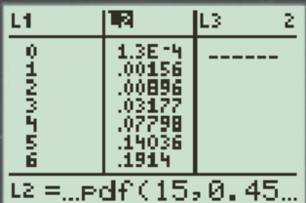

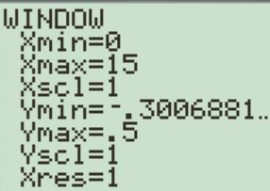
Understanding Binomial Events as a Distribution
The objective of this section is to understand the distribution of an event that is binomial
  Ie: Johnny takes 15 basketball shots at the free throw line. The probability of making an independent shot is 45%. What is the probability distribution of how many shots he can score?
On Ti 83, set L1 as the number of success
Set L2 as the binompdf(15,0.45,L1)
Draw a histogram using L1 (x-list) L2(freq)
Adjust the window, “xscl” to 1

Slide 13
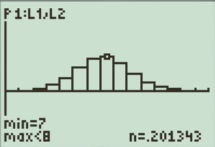
Probability Distribution of 15 trials with “x” number of success
Each bar in the diagram represents the probability of “x” number of success
What do you notice about the binomial distribution?
Symmetrical? Skewed?
Normal? Unimodal? Bimodal??

Slide 14
Using a Normal Approximation for a Binomial Distribution:
i) The Probability distribution of a Binomial Distribution is SYMMETRICAL”
ii) The distribution is symmetrical about it’s “MEAN”, the mean is given by the equation:
iii) The distribution also has a standard deviation and variance, given by the equations:
Mean:
Standard Deviation
Variance:
iv) If we change the value of “p” [probability of success] the distribution will be shifted horizontally
: smaller “p” → distribution moves to the LEFT or Larger “p” → Right

Slide 15
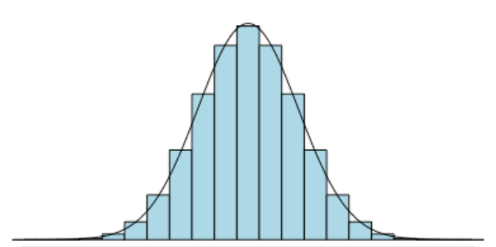
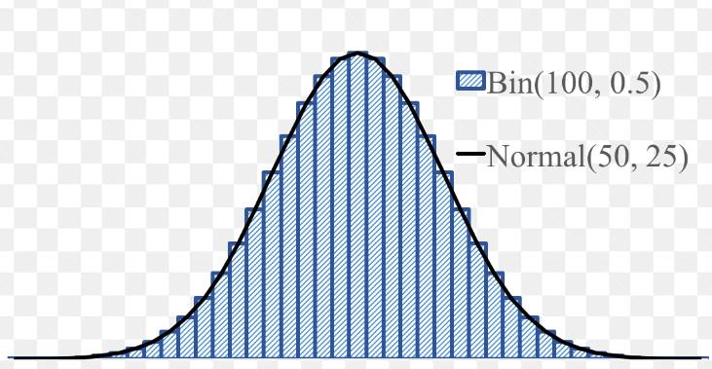
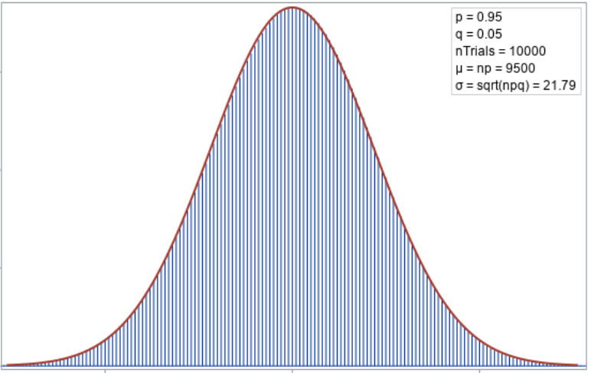

Slide 16
Characteristics of a Binomial Distribution (Continue…)
v) If the number of trials “n” is large, use a “Normal distribution” to approximate the probabilities of a Binomial Distribution
Normal Approximation:
vi) FIVE Conditions for using a Normal Distribution to approximate a Binomial Distribution: [Make sure to ALWAYS check this condition!!]
BINOMIAL: There are ONLY TWO outcomes
INDEPENDENCE: Each trial must be independent,
“N”: There must be a fixed number of trials
“P” The probability of success in each trial must be consistent
This is to ensure that the number of trials is big enough to use a normal approximation

Slide 17
Ex: A 100 question multiple choice test has choices A,B,C,D,E. If you randomly guessed all the questions and “X” is the number of correct answers you get, what is the mean and standard deviation of ”X”? What is the probability of getting 70 or more correct?

Slide 18
Ex: A 100 question multiple choice test has choices A,B,C,D,E. If you randomly guessed all the questions and “X” is the number of correct answers you get, what is the mean and standard deviation of ”X”? What is the probability of getting between 55 to 70 correct?

Slide 19
Ex: A 100 question multiple choice test has choices A,B,C,D,E. David can answer 10 questions correctly but guesses all the rest. Also, Samantha can answer 15 questions correctly but guesses all the rest. What is the probability that David will score higher than Samantha

Slide 20
Ex: A survey is conducted with a sample size of 500 on the approval of the government’s spending in BC. Suppose 65% of BC’s population approve of the spending.
a) What is the random variable X? Is it binomial?
b) Calculate the binomial probability that atmost 330 adults in sample approve of government spending
c) Can we use a normal distribution to approximate the binomial distribution? What conditions must be met?
d) Find the mean and standard deviation in the sample who indicate an approval
e) Perform a normal approximation to the question in (b). How close is the normal approximation compared to the binomial distribution?

Slide 21
a) X = the number of people that approve of the BC’s governments spending in a sample of 500 people.
X is BINOMIAL because the four conditions are satisfied
1. Each trial is independent
2. There are two outcomes: probability of approve (p=0.65) or disapprove (q=0.35)
3. There is a fixed number of people interviewed (n=500)
4. The probability for success is the same in each trial
b)
c)
d)
e)
So, yes we can use a normal distribution to approximate the binomial prob. distribution
Before we can perform a normal approximation,
it is important to show that the conditions are met:
The probabilities are off by a tiny bit….

Slide 22
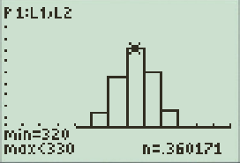
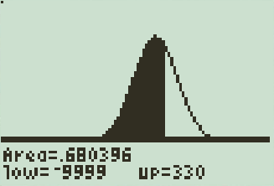
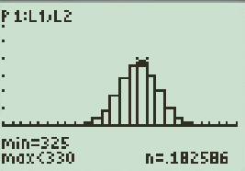
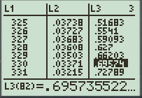
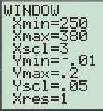
Binomial Distribution vs Normal Distribution

Slide 23
Ex: “What do you think is the ideal number of children for a family to have?” A Gallup poll asked this question to 1006 randomly chosen adults. Almost half (49%) thought two children was ideal. Suppose that p = 0.49 is exactly true for the population of all adults. Let X = number of adults who thought that two children was ideal.
Is “X” binomial? Check the four conditions for a binomial setting
Find the mean and standard deviation of X.
the probability that X = 493.
Find the probability that X is within two standard deviations of the mean
Describe the distribution of the binomial random variable X.
Are the conditions met to use a normal approximation? Justify:
Use the Normal approximation to find the area between X = 461 and X = 525. what does this area represent?
The results in Questions 4 and 7 should be extremely close.
Why would this be so?

Slide 24
a)There are two outcomes: Thinking that two children is ideal (success) and not thinking two children is ideal (Failure). The probability of success (0.49) is the same for each trial. The trials are independent, and there is a fixed number of trials (1006)
b)
c)
d)
e) The binomial distribution is approximately normal with a mean of 492.94 and a standard deviation of 15.856
f)
G) Larger sample sizes give better approximations to the normal distribution. So the Normal approximation estimation will be close to the binomial probability

Slide 25
Approximating a Binomial Distribution with a Normal Distribution:
When the number of trials get bigger, finding the probabilities for a binomial distribution can be “awkward” or difficult
To overcome this problem, we can use a “normal distribution” to approximate a “binomial distribution” when “n” is large
Using a normal distribution makes calculations easier to perform.
However, certain conditions must be met to use a “normal distribution” to approximate the probabilities from a binomial distribution:
Conditions
It must be binomial (2 outcomes)
Each trial must be independent, there must be a fixed number of trials
The probability of success in each trial must be consistent
This is to ensure that the number of trials is big enough to use a normal approximation

Slide 26
Mean and Standard Deviation
If “X” is a binomial random variable, with “n” number of trials, and “p” probability of success in each trial, the mean and standard deviation is given by:
Mean
Standard Deviation
Ex: A 100 question multiple choice test has choices A,B,C,D,E. If you randomly guessed all the questions and “X” is the number of correct answers you get, what is the mean and standard deviation of ”X”? What is the probability of getting 70 or more correct?

Slide 27
Homework:
TPS 8.1, 8.3, 8.4, 8.5, 8.8, 8.11, 8.12
TPS 8.13, 8.14, 8.16, 8.23
TPS 8.19, 8.24, 8.27, 8.29, 8.30

Slide 28
Combinations (Binomial Coefficient)
The total number of ways to choose “r” number of objects from “n” total objects is:
Ex: There are five students Amy, Brad, Chris, Don, and Eva. Three of them will be selected to form a team. How many different teams are possible?
10 different teams
are possible
b) If four of them are selected to form a team, how many different teams are possible?

Slide 29
Ex: Evaluate the following expressions:
OR
OR
© Copyright all rights reserved to Homework depot: www.BCMath.ca

Slide 30
c) What is the probability that you will pass the test?
d) What is the probability that you will get 90% on the test?
There’s a probability of 7.8% that you will pass the test

Slide 31
Activity 8A
For each of the following questions, circle either A, B, C, or D
Question 1: A B C D
Question 2: A B C D
Question 3: A B C D
Question 4: A B C D
Question 5: A B C D
Question 6: A B C D
Question 7: A B C D
Question 8: A B C D
Question 9: A B C D
Question 10: A B C D
How many did you get correct?

Slide 32
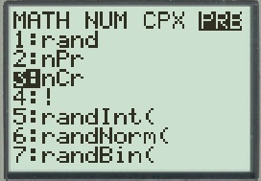
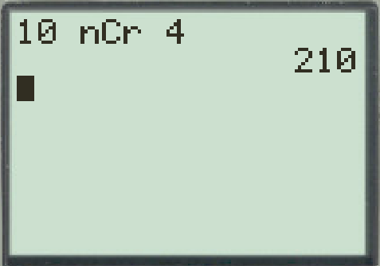
Ex: A quiz has 10 questions, in how many different ways can you get 4 questions correct?
OR
Press:
Math → PRB
→ Enter
Type 10 nCr 4
There are 210 ways
to get 4 correct answers from 10 different questions

Slide 33
Why the variance of a binomial distribution:
The variance of a binomial distribution is npq. Explanation:
1. The variance of our random variable “x” is
For each single output of one event, you only have two outcomes. Success or failure with a binomial event: So you have:

Slide 34
So now image that you have “n” separate events
The variance of “n” separate outcomes would then be:

